Slide 1
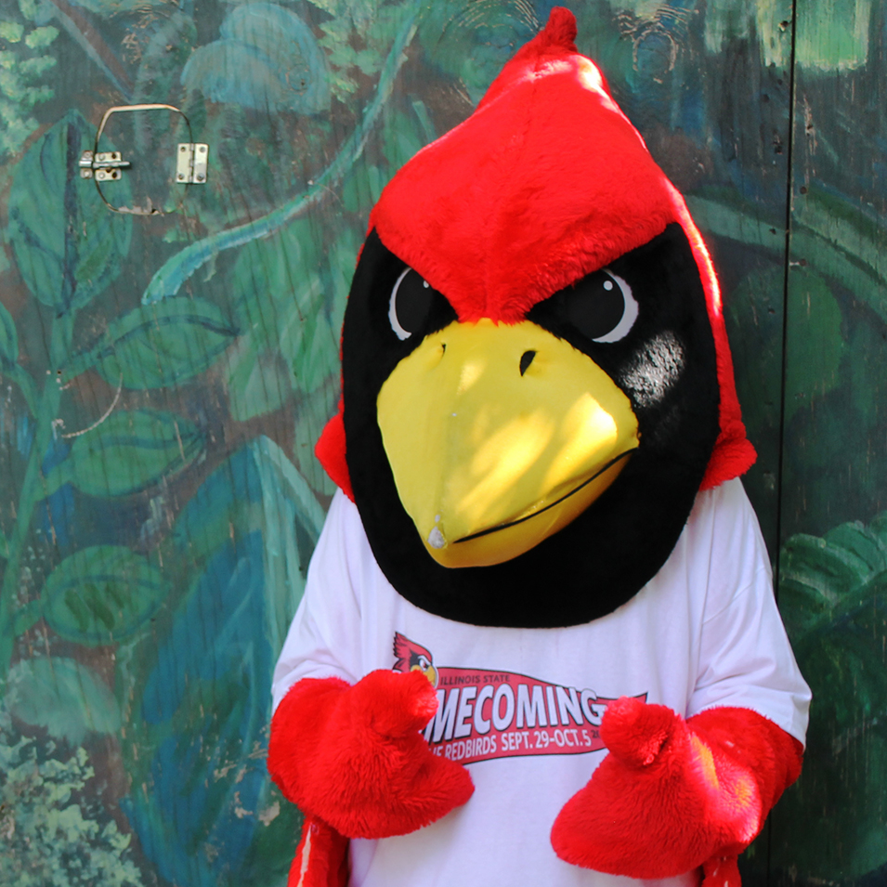
#RedbirdProud

